Slide 1
OWASP_TOP_TEN_PROJECT
ONYEKWERE CHIDI ALWELL

Slide 2
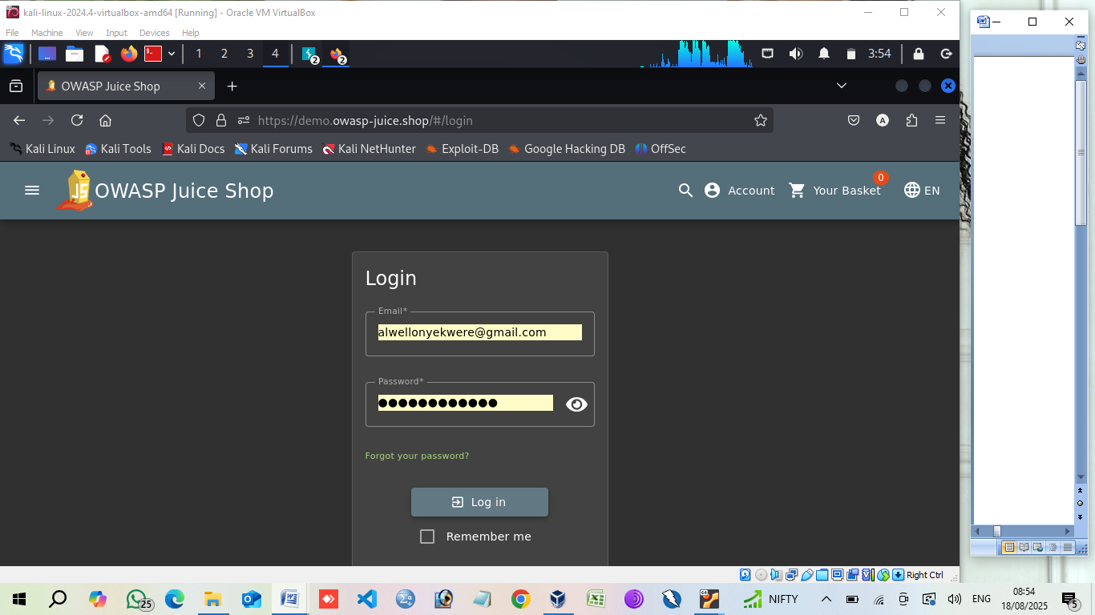

Slide 3
BROKEN ACCESS CONTROL

Slide 4
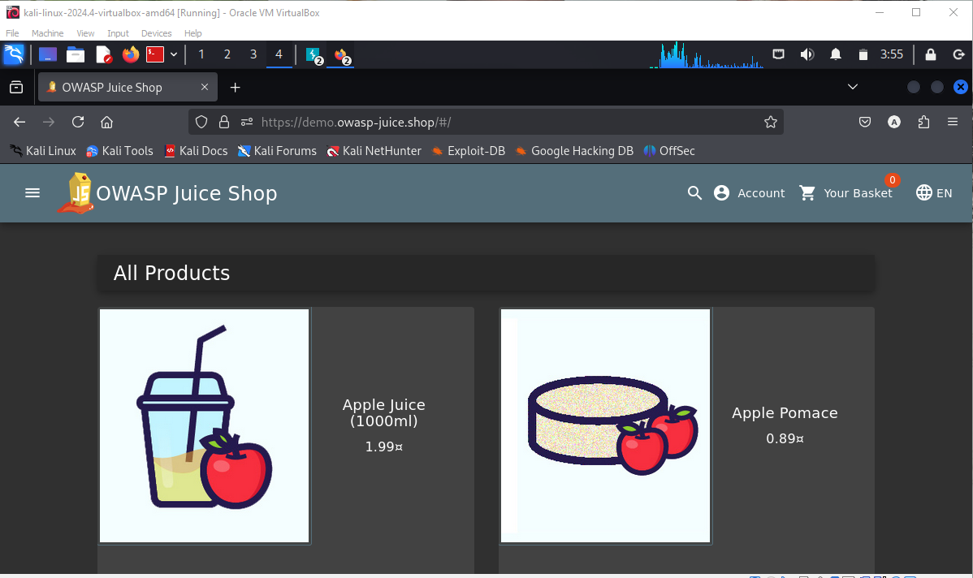

Slide 5
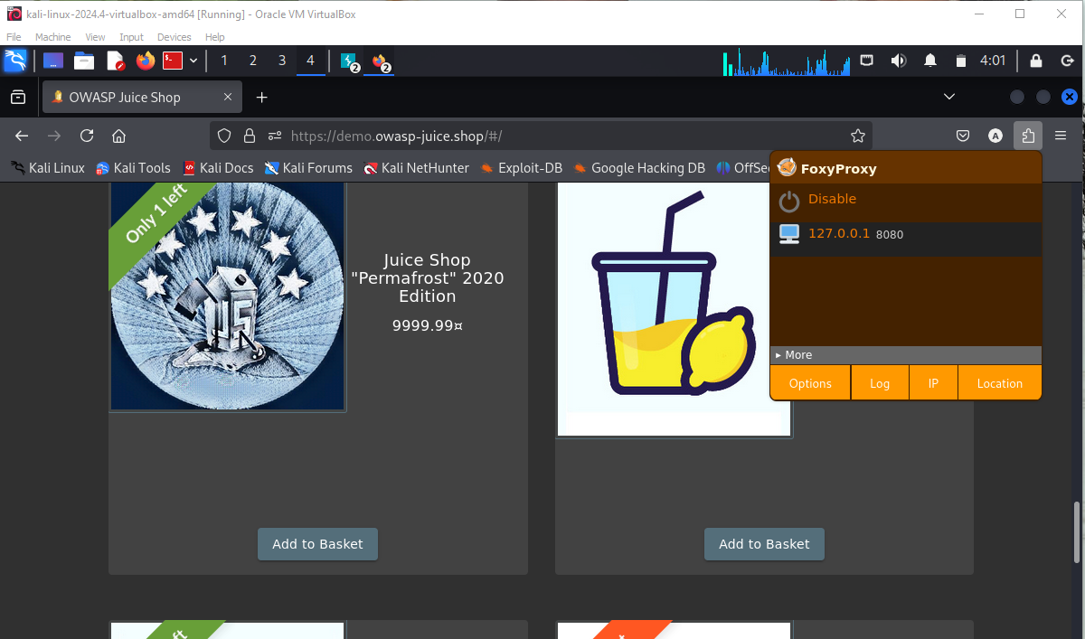

Slide 6
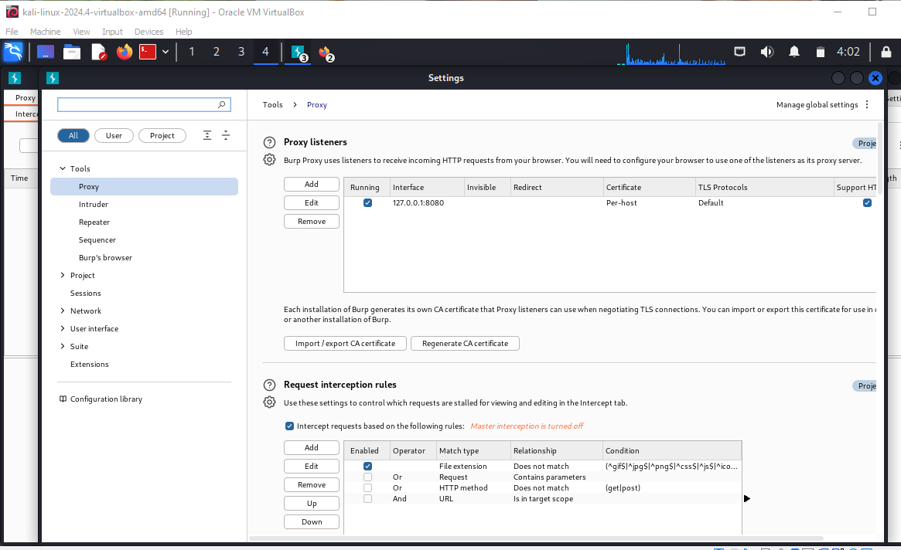

Slide 7
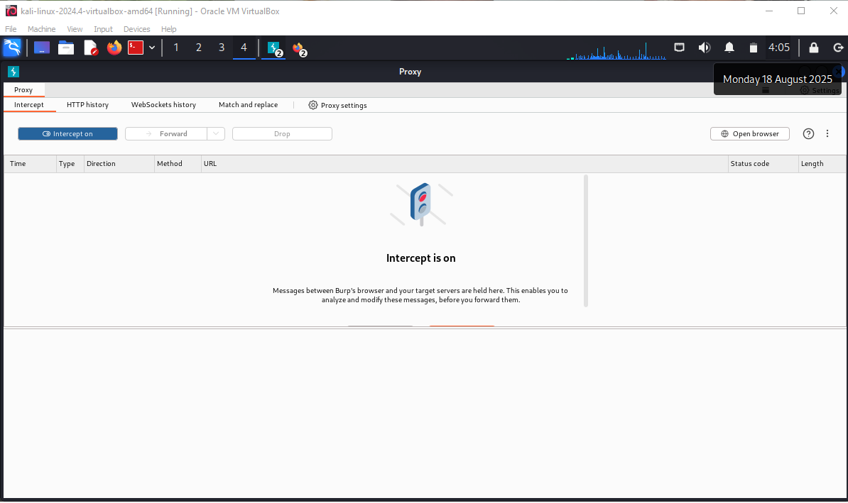

Slide 8
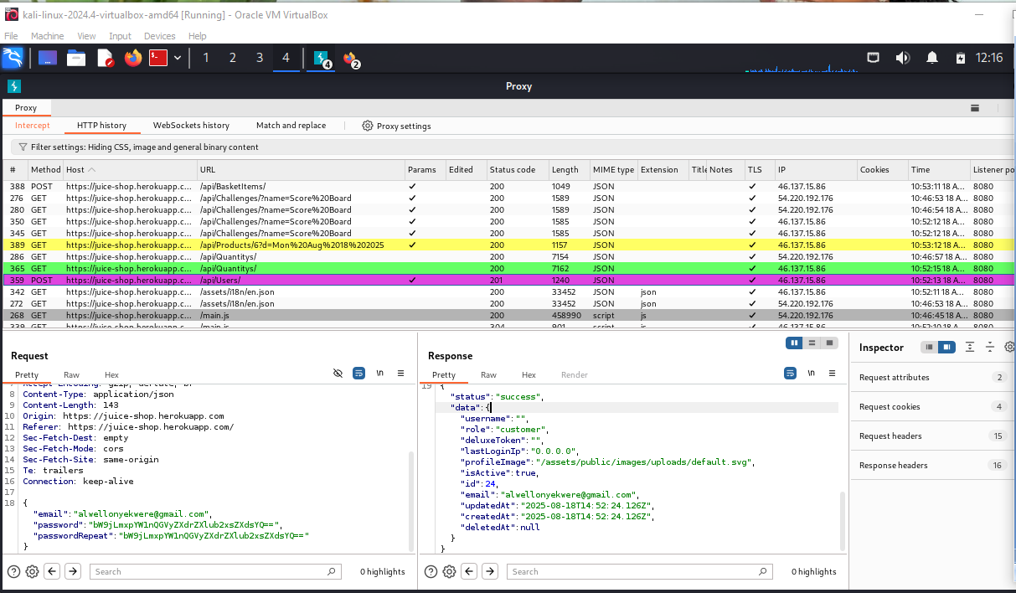

Slide 9
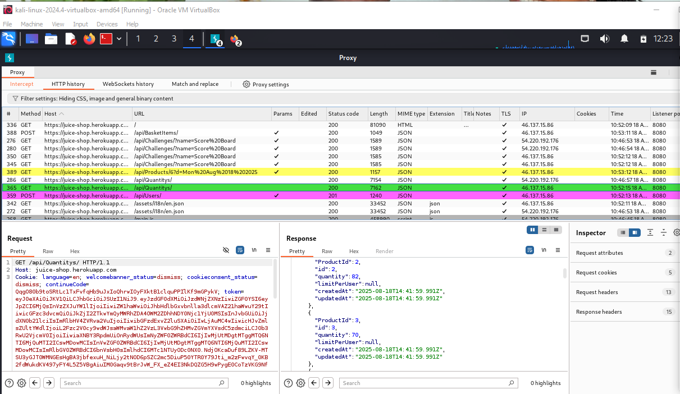

Slide 10
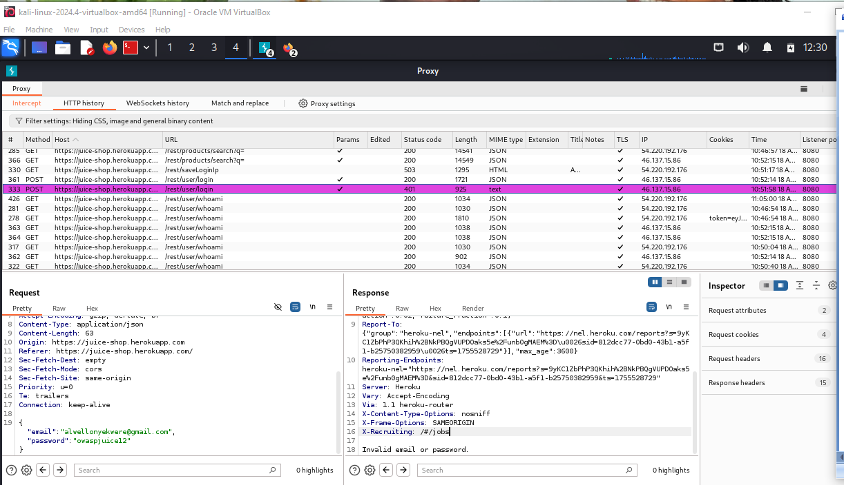

Slide 11
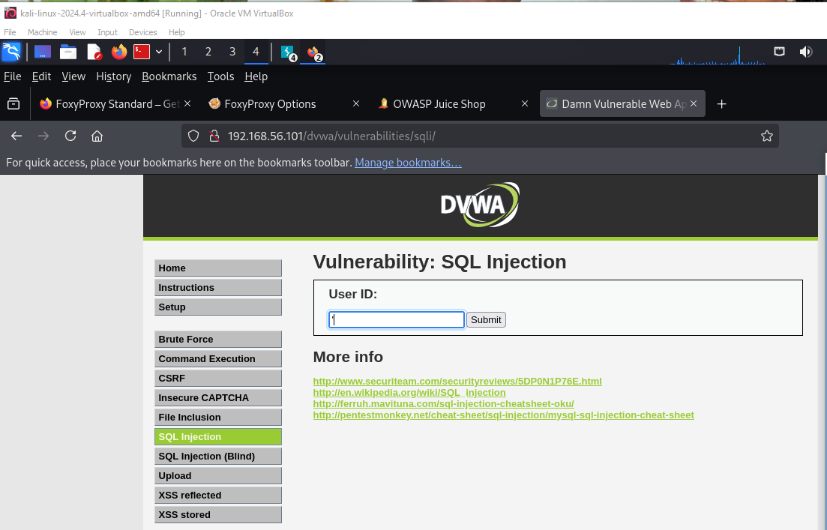

Slide 12
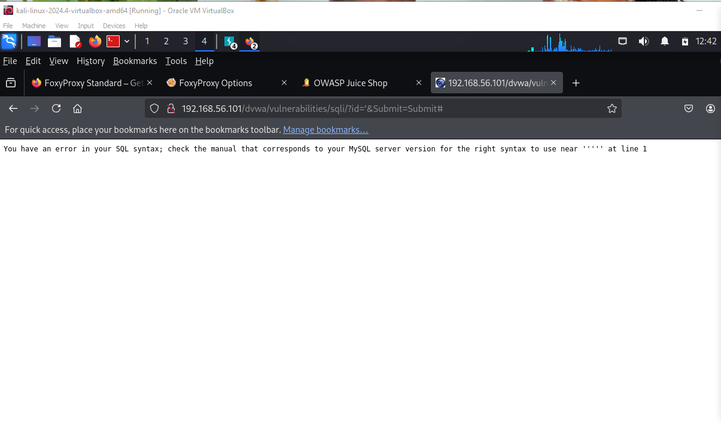

Slide 13
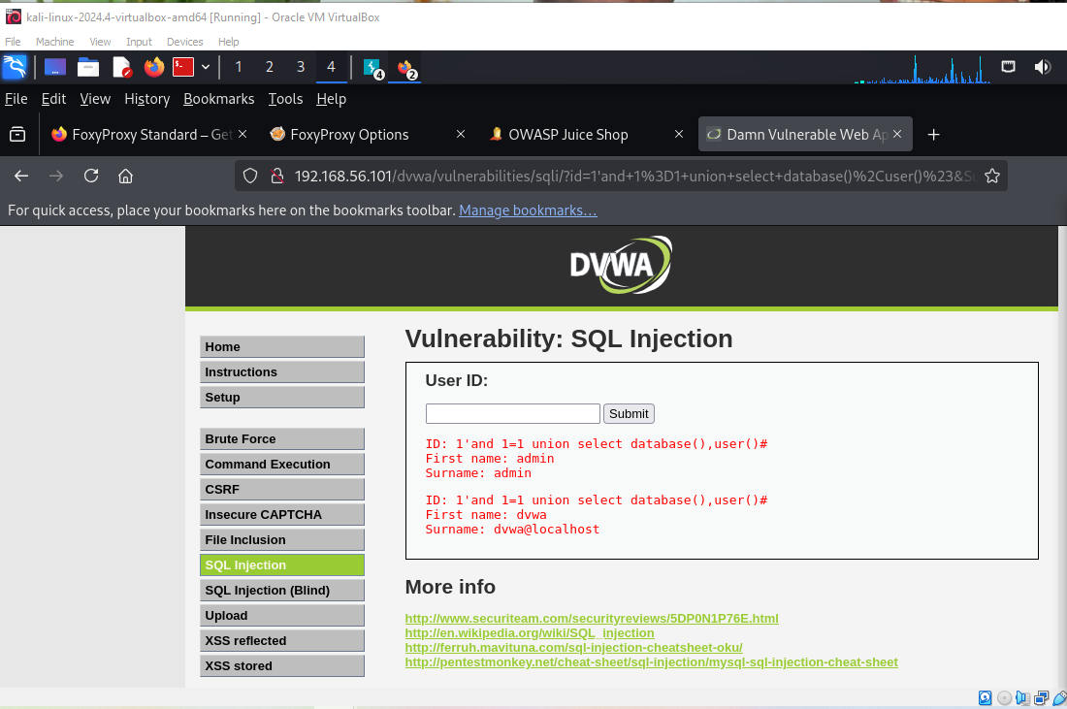

Slide 14
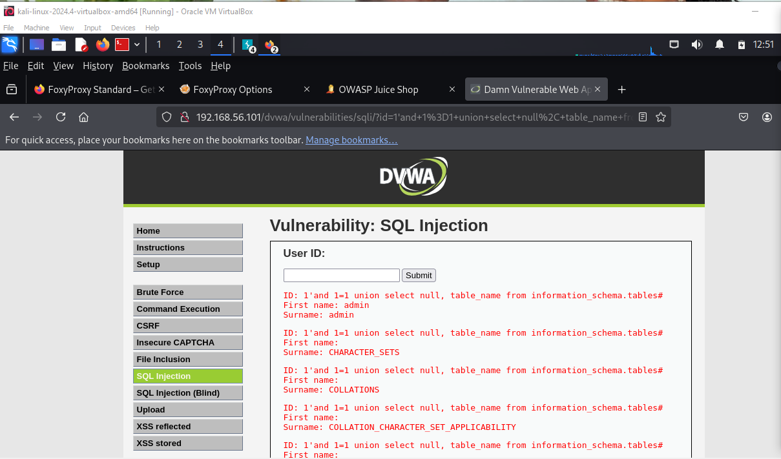

Slide 15
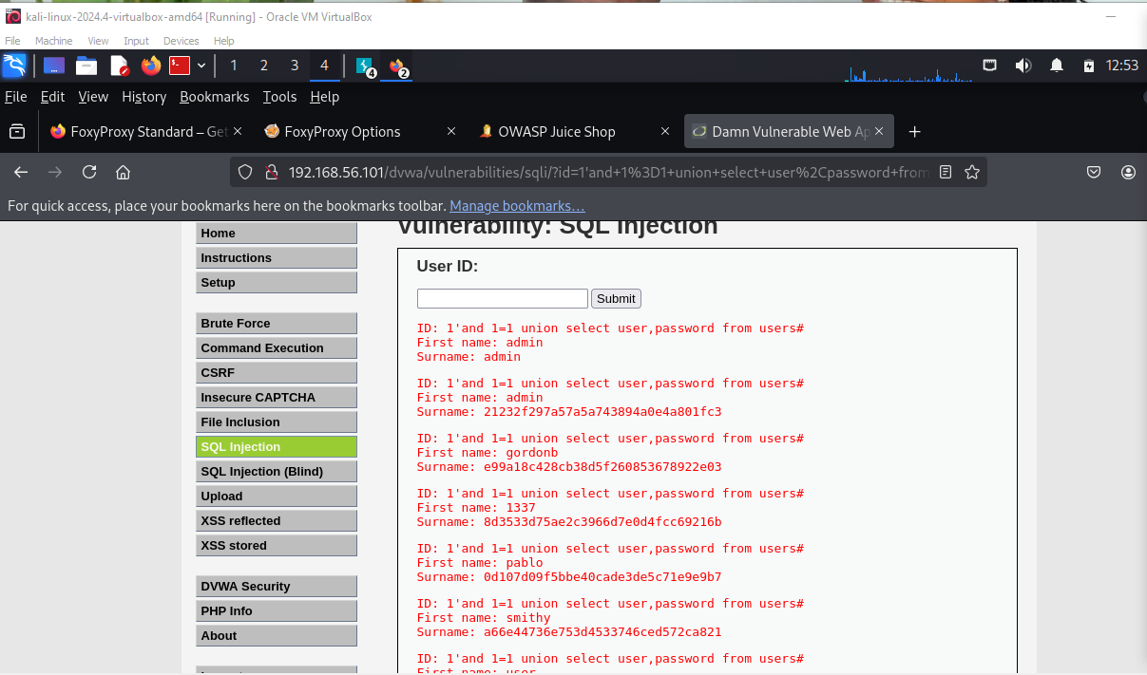

Slide 16
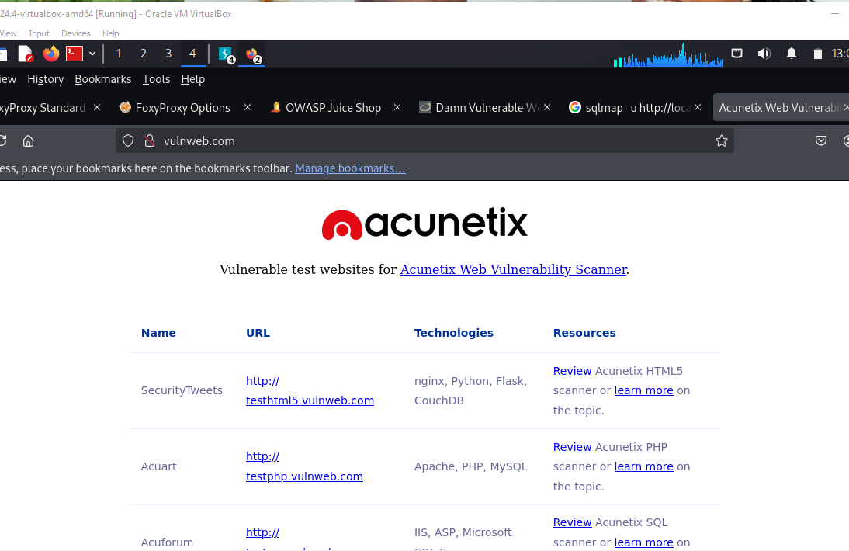
Automated injection

Slide 17
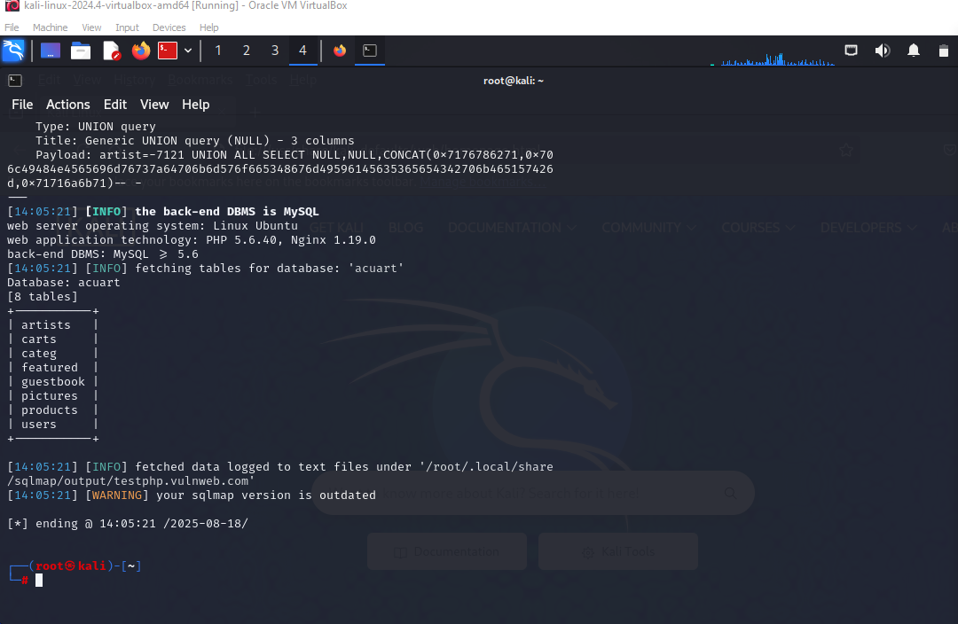

Slide 18
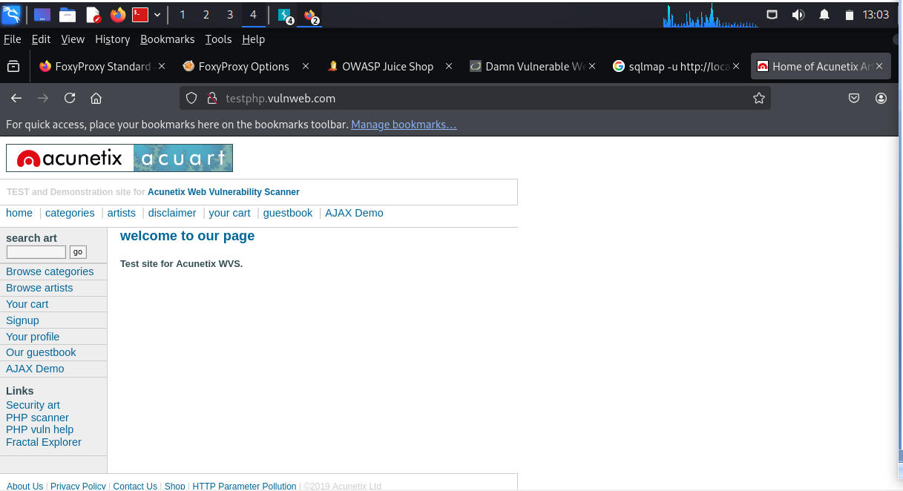
Predictable flaws(http://192.168.56.101 dvwa)

Slide 19
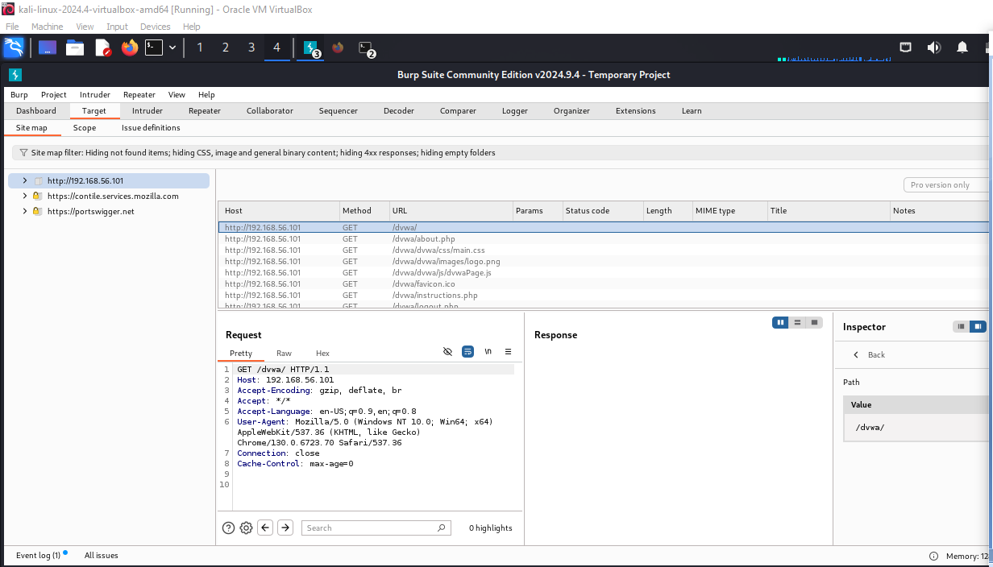

Slide 20
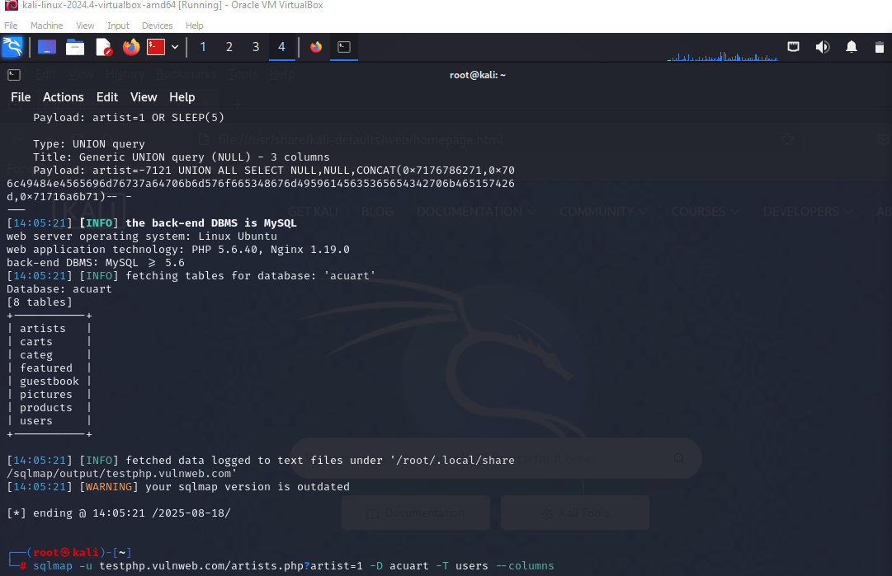

Slide 21
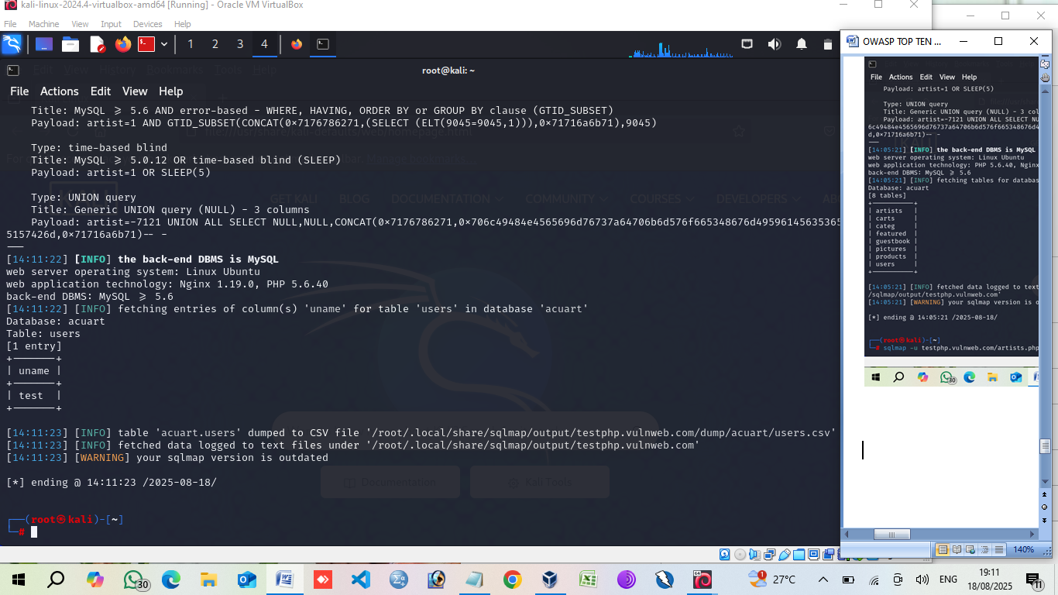

Slide 22
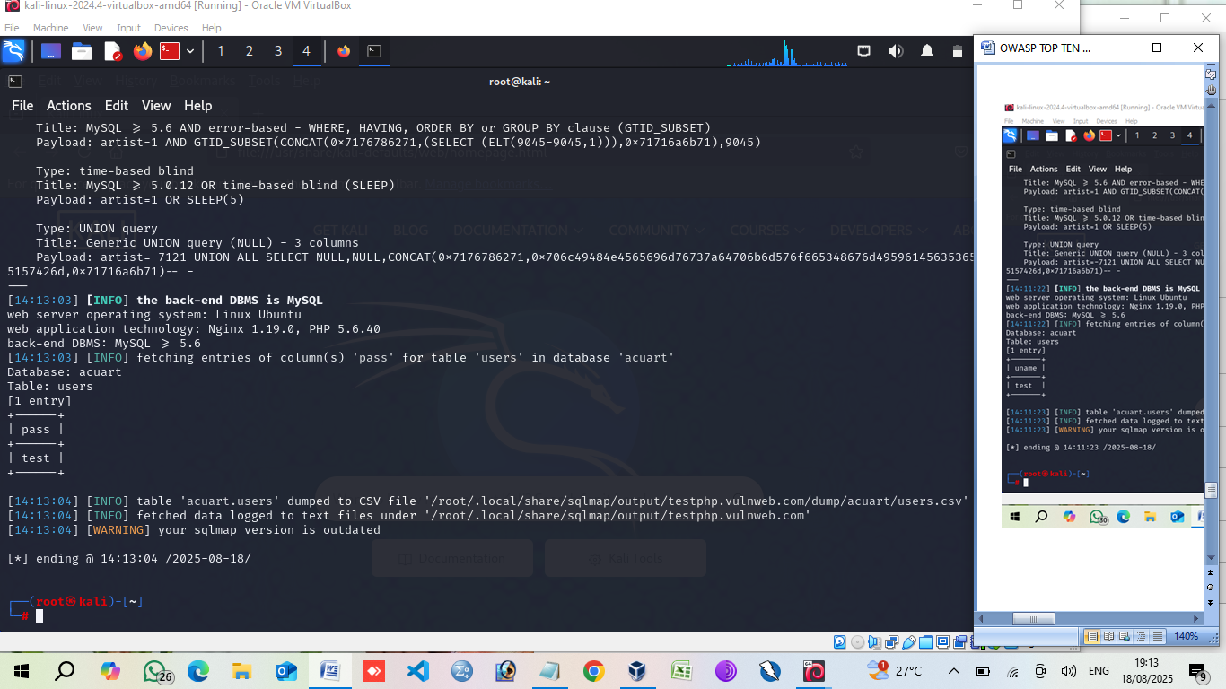

Slide 23
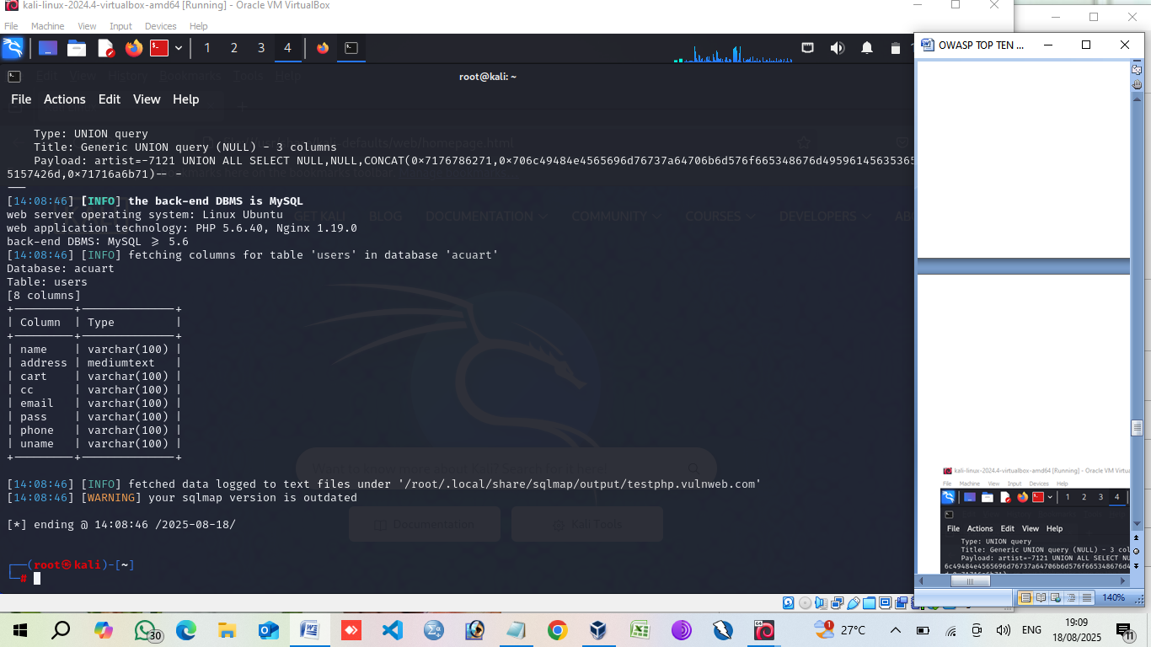

Slide 24
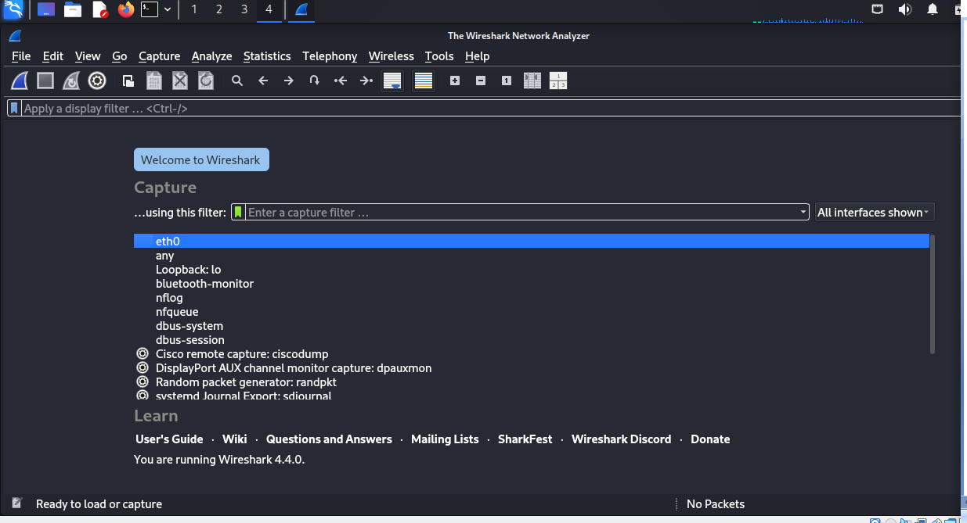
Credentials leak (wireshark)

Slide 25
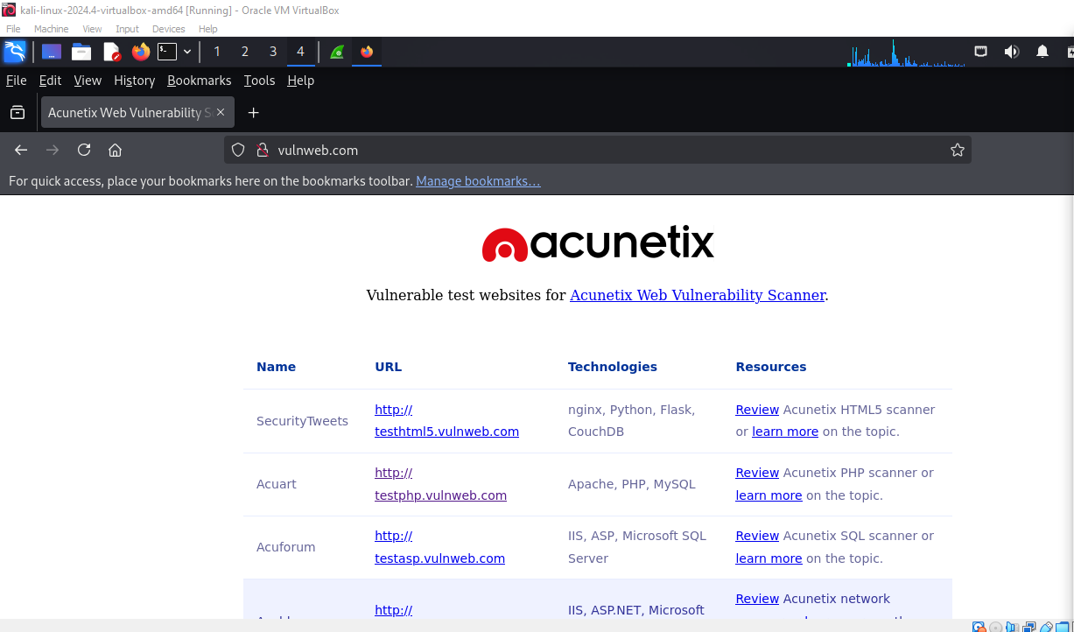

Slide 26
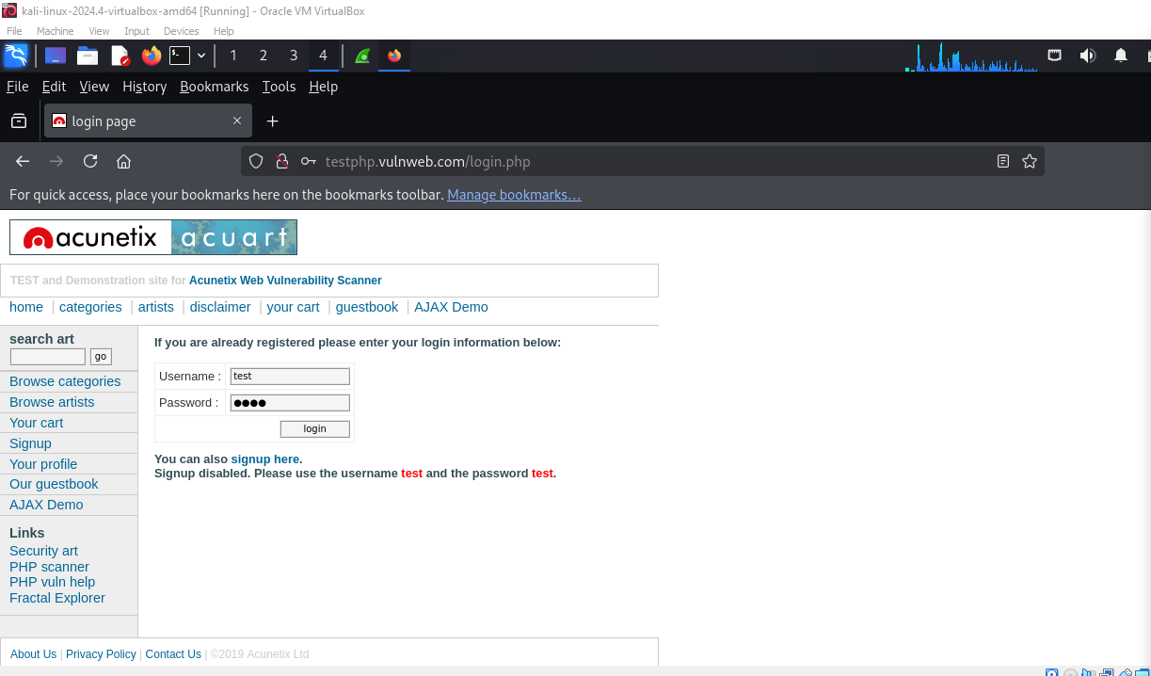

Slide 27
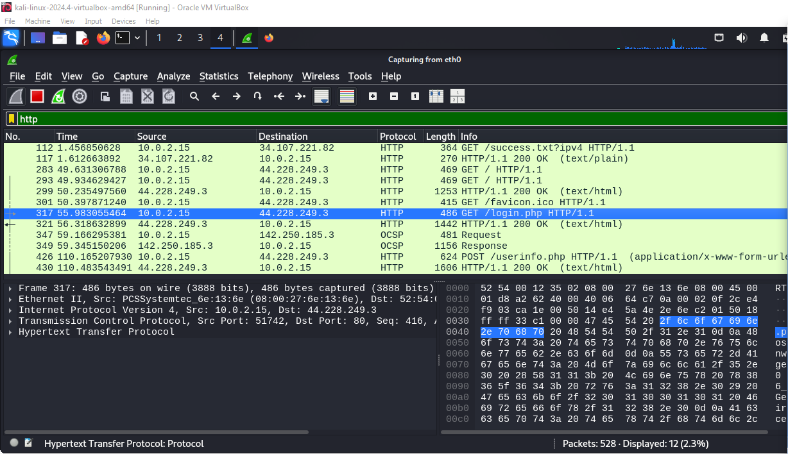

Slide 28
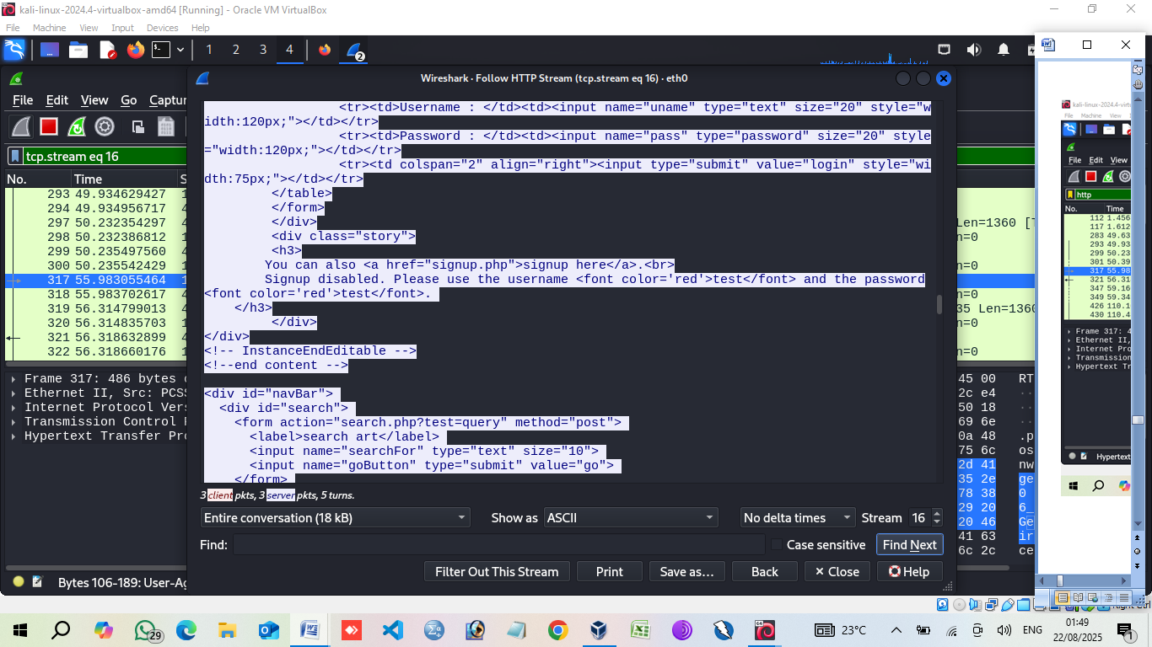

Slide 29
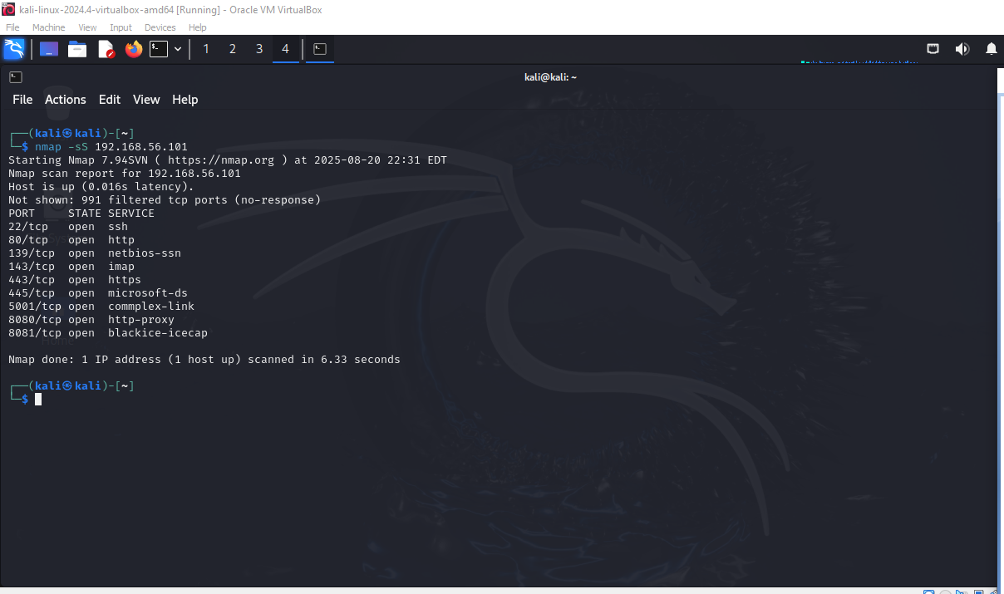
Port & service enumeration (nmap) Nmap –sS <target>

Slide 30
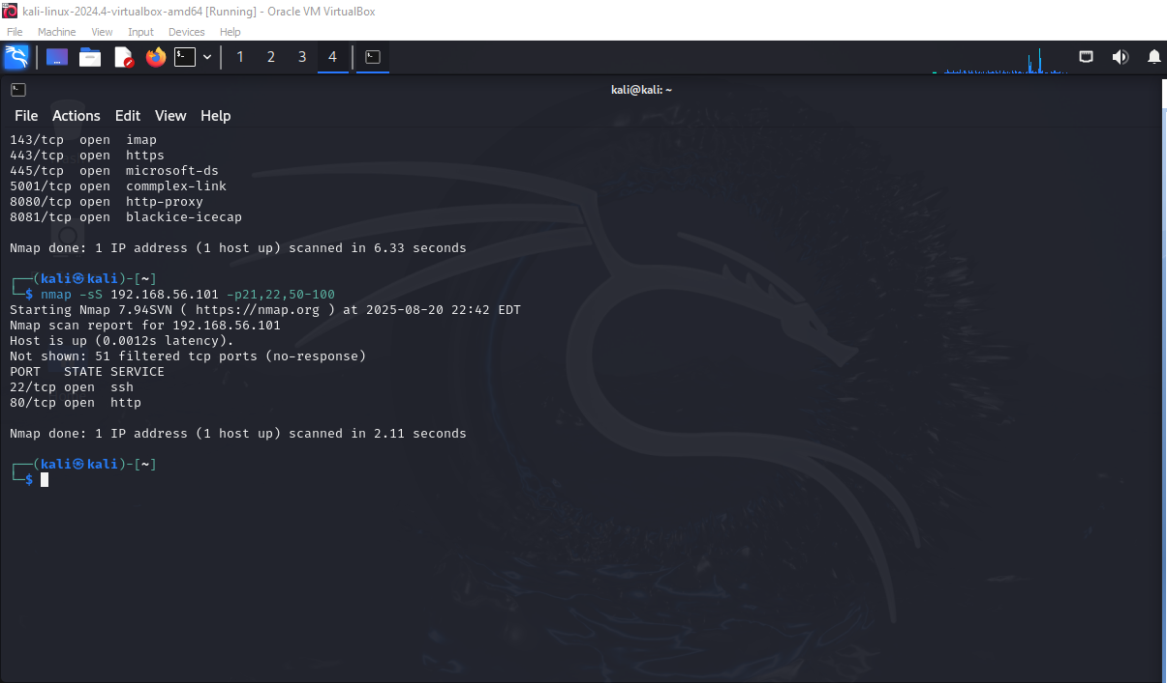
No.5 Nmap –sS <target> -p21, 22, 58-100

Slide 31
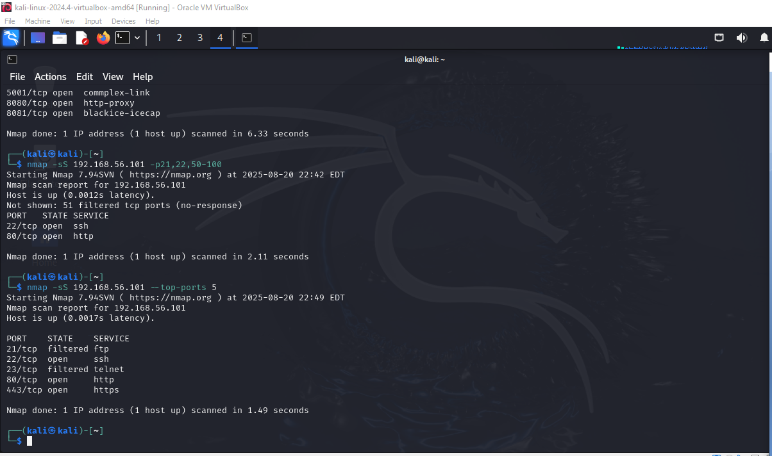
Nmap –sS 192.168.56.101 –top-port 5

Slide 32
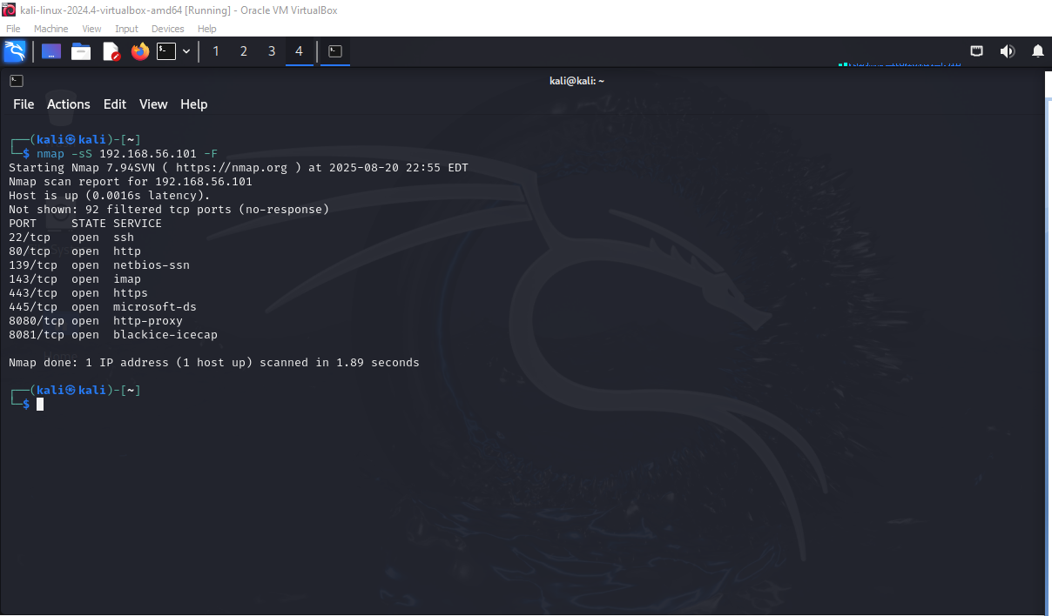
Nmap sS <target> -F (scan for 100 ports)

Slide 33
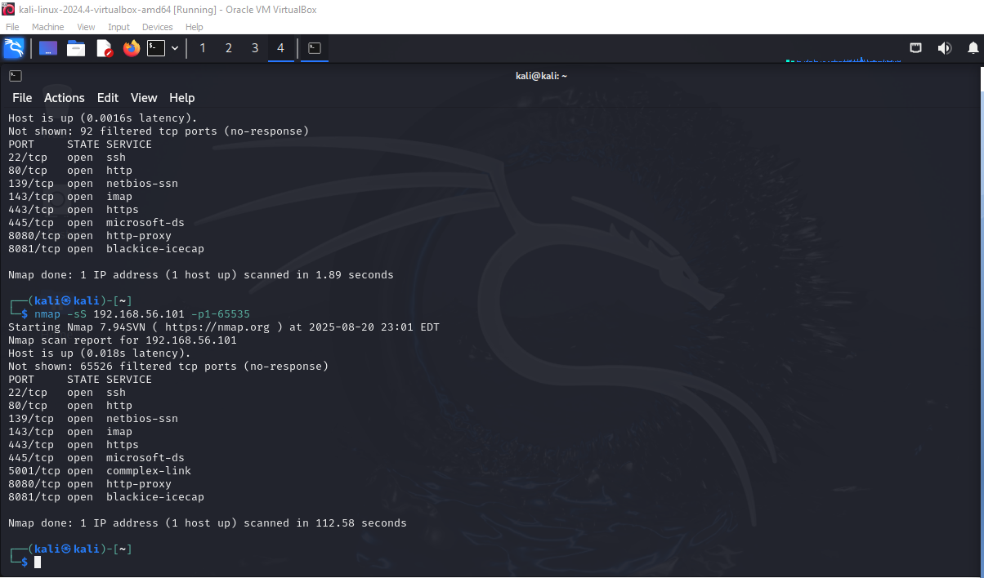
Nmap sS <target> - P1-65535 (scan the entire range of ports)

Slide 34
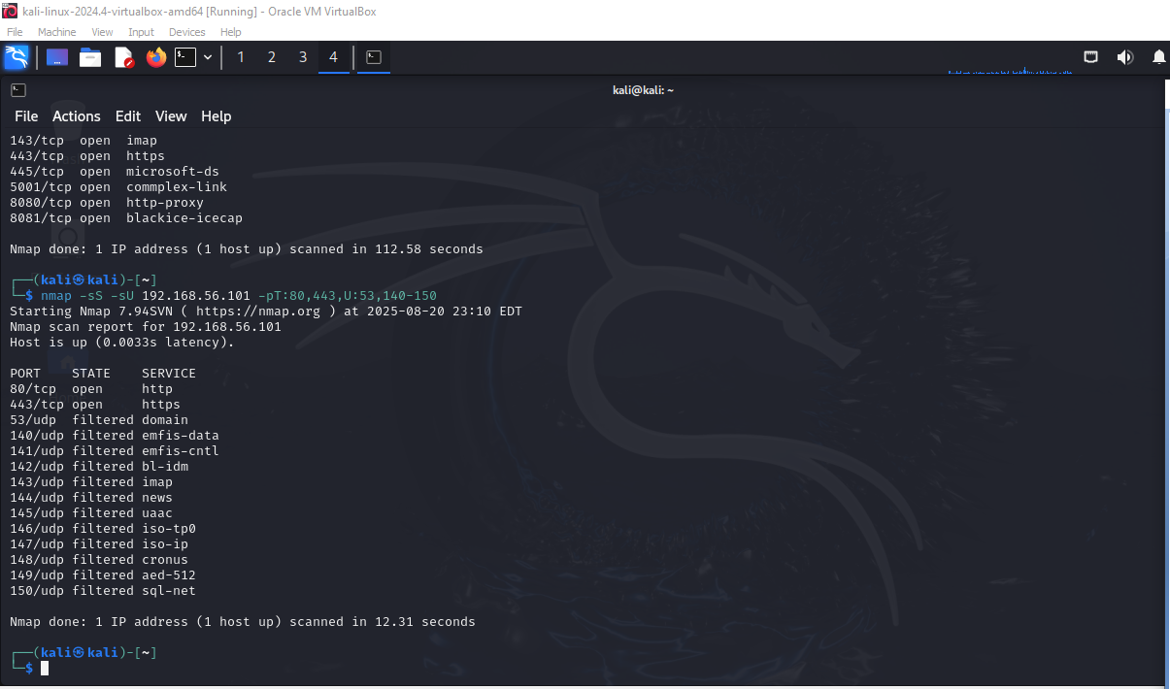
Nmap -sS -sU <target> - PT:80,443,U:53,140-150 (scan for udp ports)

Slide 35
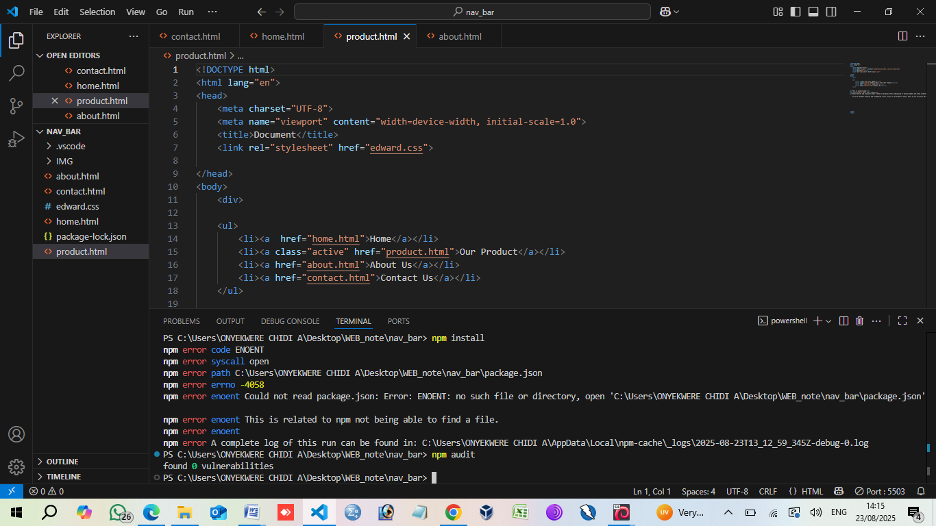
6: vulnerabilities and outdated components(npm)

Slide 36
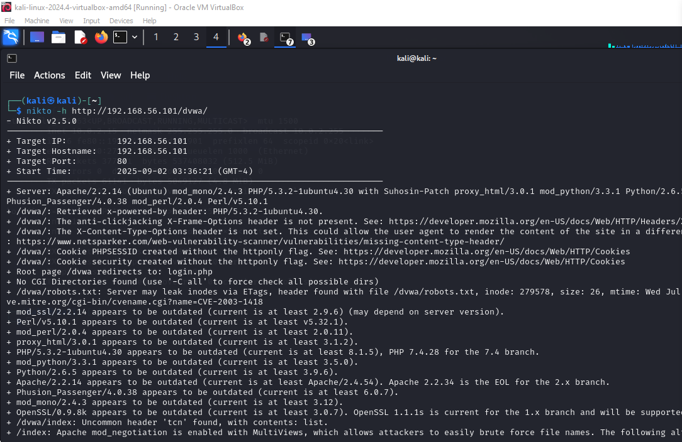
DETECTS KNOWN SERVER VULNERABILITIES (nikto)

Slide 37
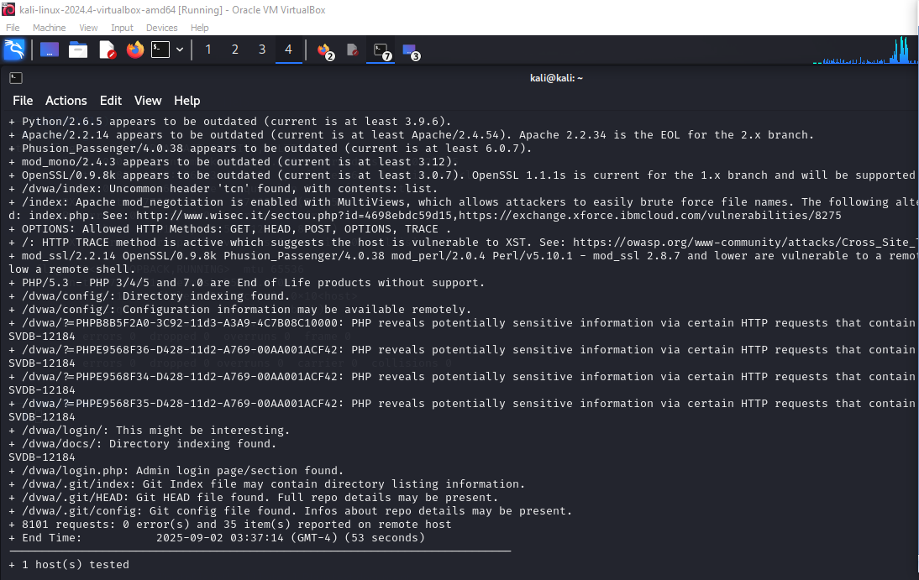

Slide 38
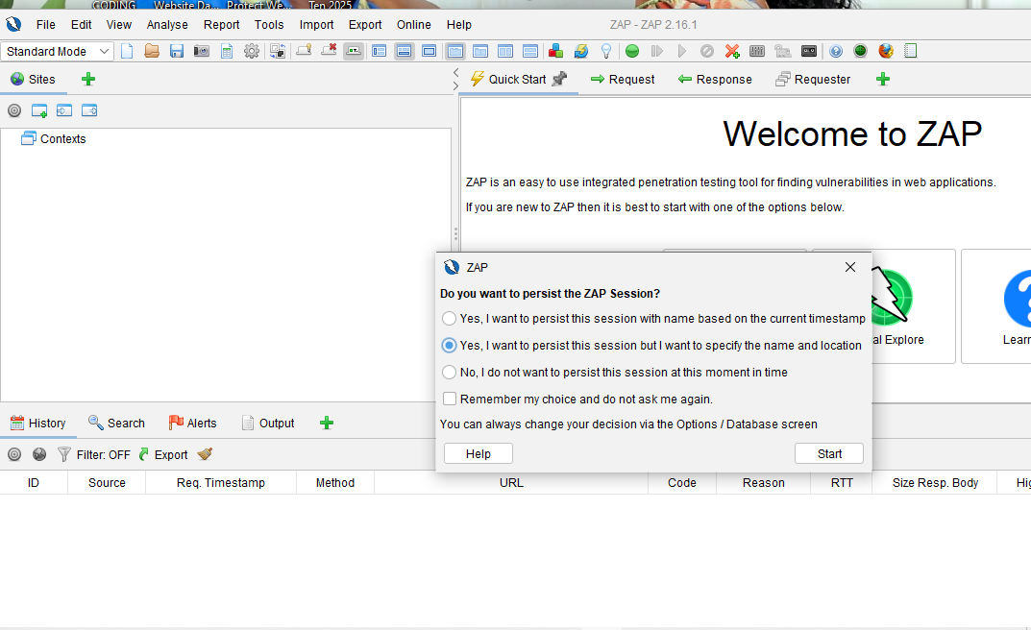
zap

Slide 39
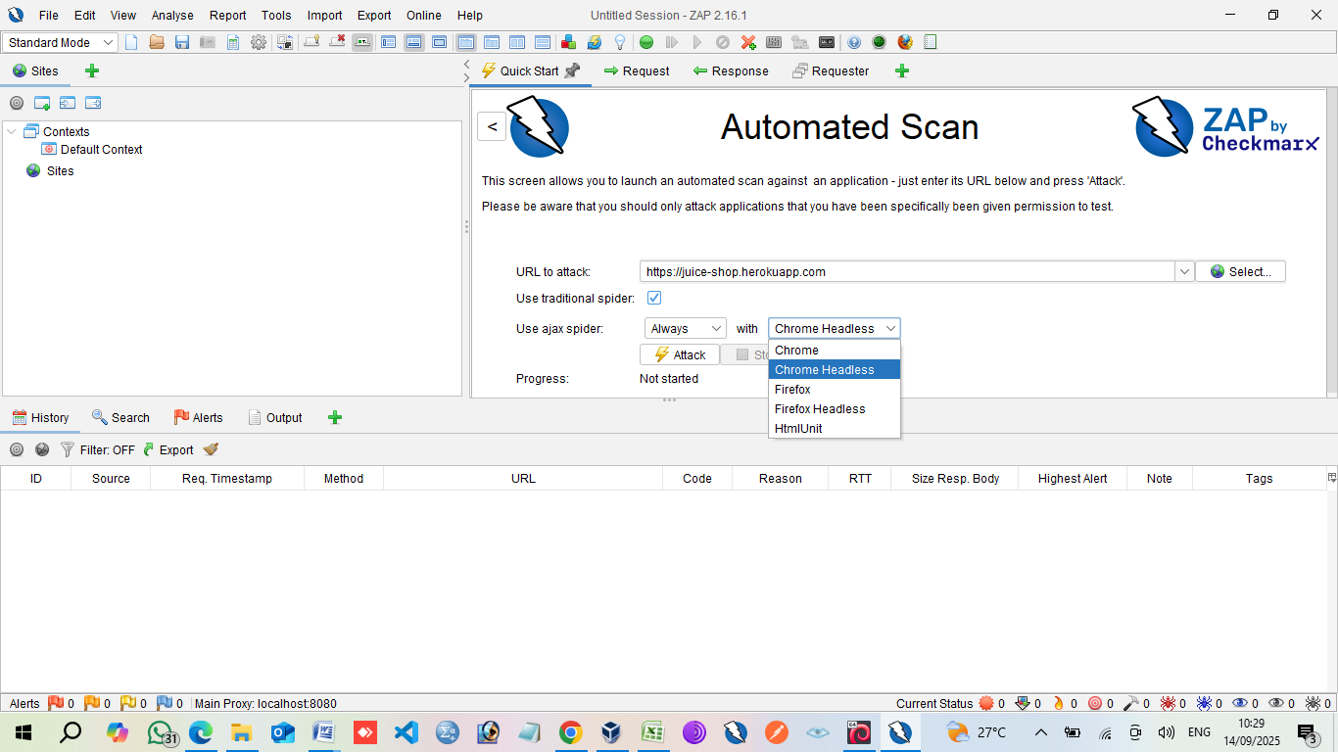
Paste the URL, set to Chrome Headless

Slide 40
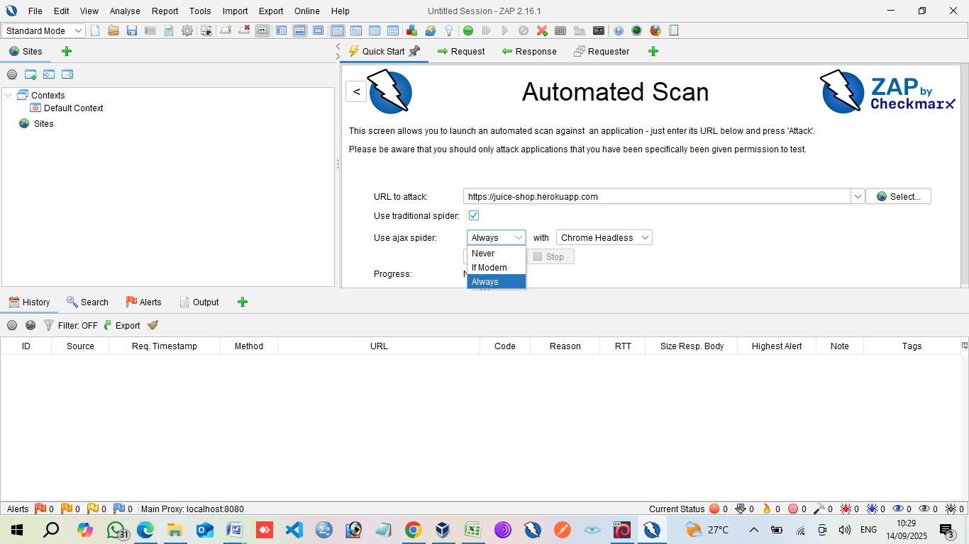
Set the use ajax spider as Always.

Slide 41
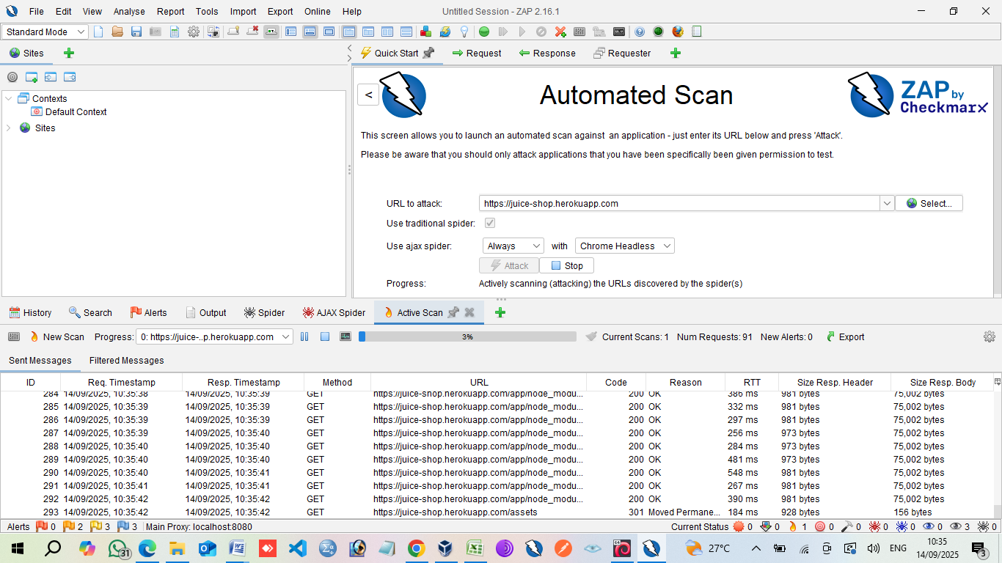

Slide 42
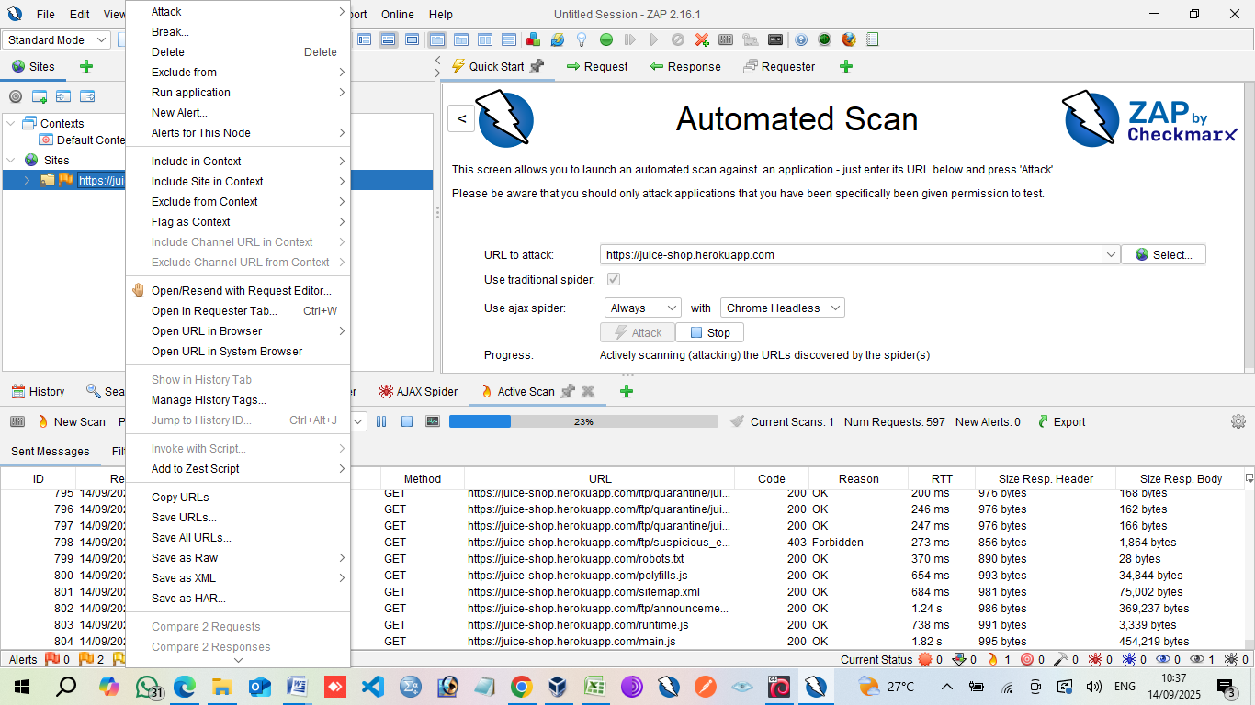

Slide 43
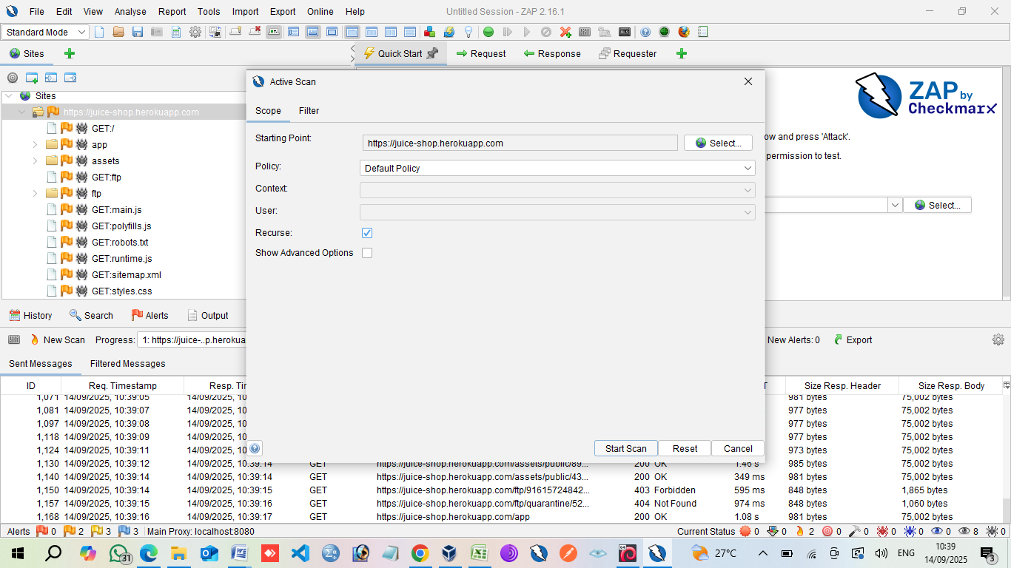
Active Ascan

Slide 44
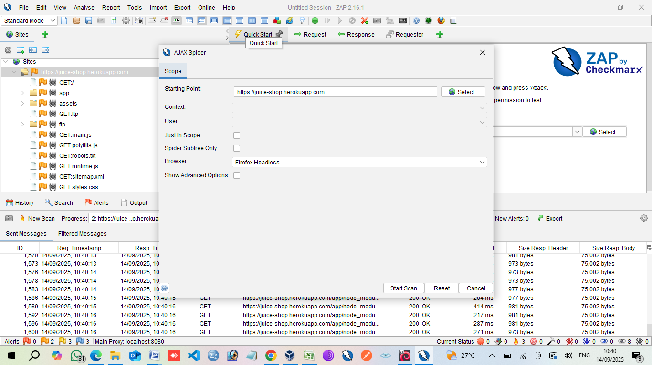
AJAX Spider

Slide 45
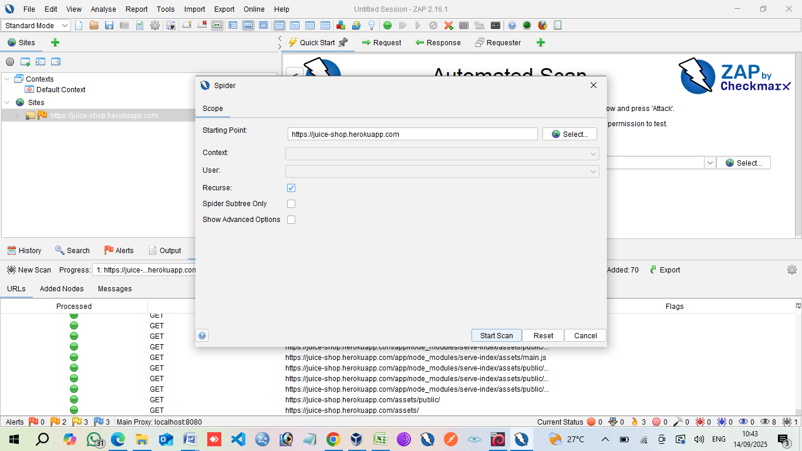
Spider

Slide 46
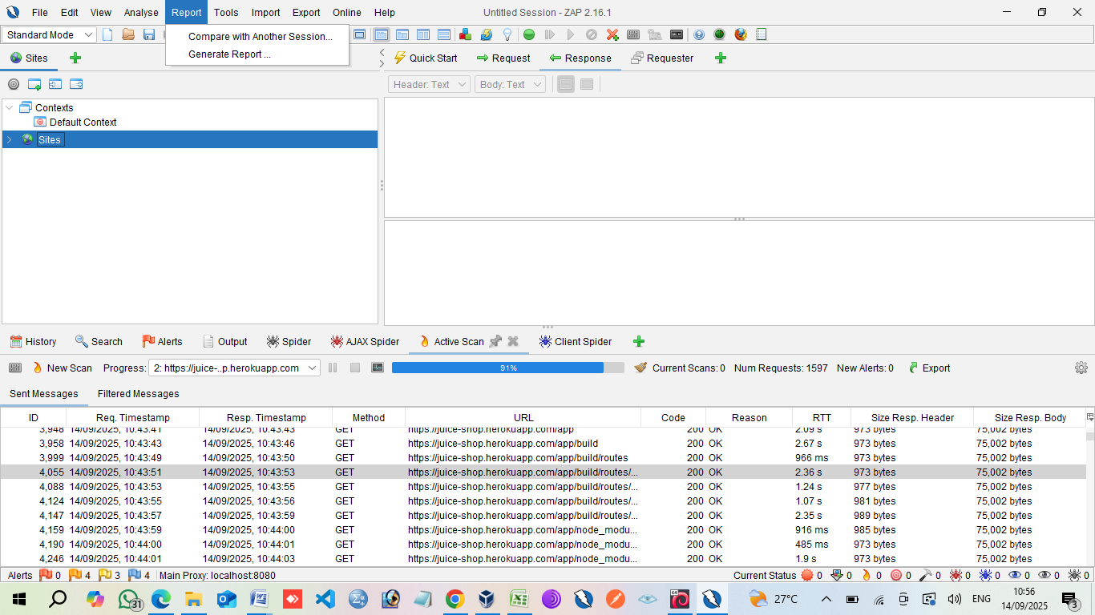
Report

Slide 47
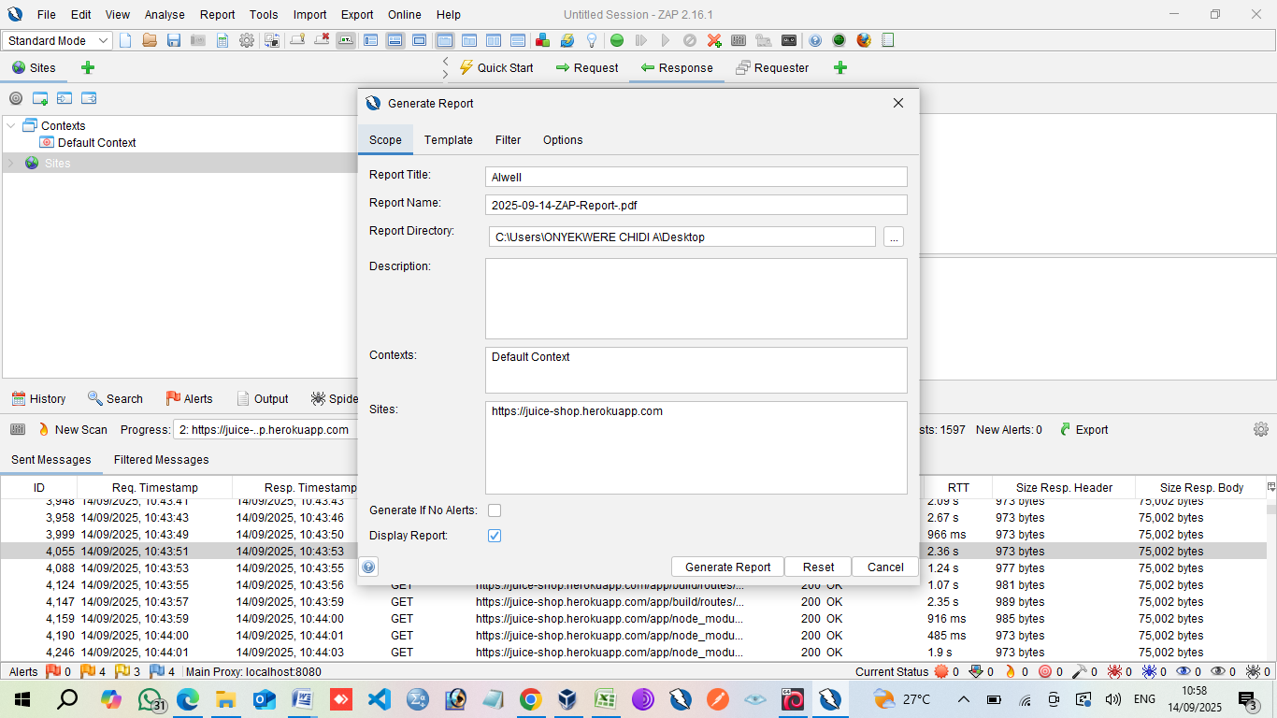

Slide 48
Owasp_zap report

Slide 49
Manual zap_report

Slide 50
THANK YOU

